Slide 1
Congressional Stock Analysis
Do Congress Members Beat the Market?
Machine Learning on STOCK Act Disclosures · March 2026

Slide 2
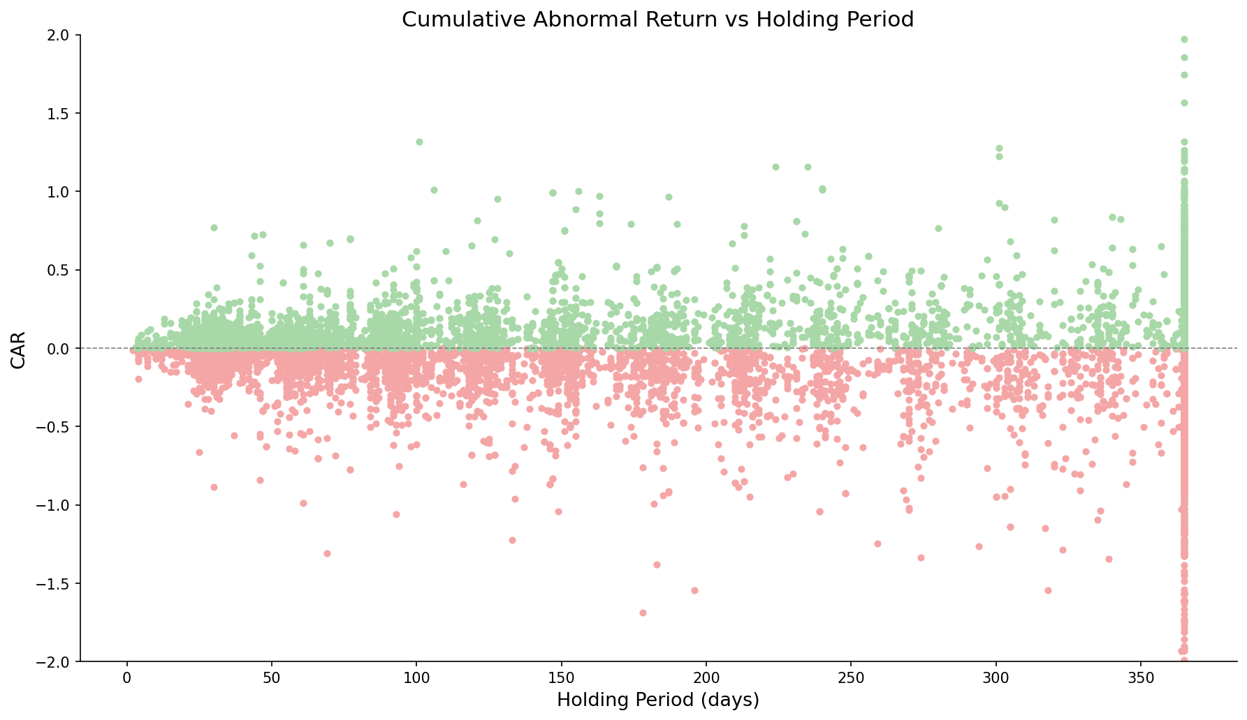
Most Congressional Purchases Underperform the Market
15k
Total modeled trades
-0,5%
Median CAR
48.5%
Win rate

Slide 3
How We Measure Performance: Cumulative Abnormal Return (CAR)
Cumulative Abnormal Return (CAR)
Positive CAR (+)
Negative CAR (-)
Compensated MORE for risk than CAPM predicts
Compensated LESS, paid for risk that did not materialize
For each day, calculate the excess return relative to the stock's expected risk-adjusted return, then accumulate those daily excesses over the window.
CAPM
E[R] = R, + B x (Rm - R,)
Beta (B) estimated from 756 trading days of close prices (min 60 days).
Window
Measured buy-to-sell (if <12 months) or a fixed 12-month window.
The clock starts the day AFTER the public filing date
Excess return actual log return – CAPM-expected log return

Slide 4
Who Consistently Beats — and Loses to — the Market?
Top 10 winners
Worst 10 performers
29
-1
-3
-5
-6
4
5
5
2
2
-19
Median CAR
John F. Reed (n=63)
Bradley S. Schneider (n=22)
Suzan K. Delbene (n=21)
David P. Joyce (n=51)
John Boozman (n=45)
Victoria Spartz (n=20)
Donald Sternoff Beyer Jr (n=299)
Mo Brooks (n=24)
Dan Sullivan (n=35)
Debbie Wasserman Schultz (n=20)
Hit Rate
Median CAR
Austin Scott (n=35)
Mrs. Marjorie Taylor Greene (n=22)
Tom Malinowski (n=104)
C. Scott Franklin (n=26)
James Comer (n=27)
Michael Patrick Guest (n=43)
Carol Devine Miller (n=55)
Daniel Goldman (n=307)
Daniel Meuser (n=26)
Patrick Fallon (n=57)
Hit Rate
▸ Based on 101 politicians with ≥ 20 disclosed purchases
▸ evaluated based on CAR performance, amount of $ traded was not considered
Median Car
Hit Rate

Slide 5
Performance Over Time: Macro Events Drive Positive Rates
Performance over the years
1.208
710
651
707
658
501
545
568
496
496
475
472
317
312
355
351
116
190
168
189
89
95
108
78
92
# of trades
2015Q1
2015Q2
2015Q3
2015Q4
2016Q1
2016Q2
2016Q3
2016Q4
2017Q1
2017Q2
2017Q3
2017Q4
2018Q1
2018Q2
2018Q3
2018Q4
2019Q1
2019Q2
2019Q3
2019Q4
2020Q1
2020Q2
2020Q3
2020Q4
2021Q1
2021Q2
2021Q3
2021Q4
2022Q1
2022Q2
2022Q3
2022Q4
2023Q1
2023Q2
2023Q3
2023Q4
2024Q1
2024Q2
2024Q3
2024Q4
2025Q1
Hit Rate
▸ 2020 Q2–Q3: surge in positive rate — COVID recovery bounce lifted most purchases
▸ 2022: sharp drop aligned with rate-hike drawdown across the market
▸ Volume spikes suggest increased trading activity around election cycles
▸ Positive rate rarely exceeds 60% — even in the best macro environments
# of trades
Hit Rate

Slide 6
EDA: Median CAR Across Key Structural Variables
Party Influence
Disclosure delay (days)
Committee influence
Median CAR
Democrat
Republican
Hit Rate
Median CAR
0-10d
10-20d
20-30d
30-40d
40-45d
45-50d
50d+
Hit Rate
Median CAR
No Match
Tier 1 (Tangential)
Tier 2 (Oversight)
Tier 3 (Direct)
Hit Rate
▸ Disclosure delay capped at 45 days by STOCK Act; 50d+ entries reflect late filers
Median CAR
Hit Rate

Slide 7
Committee Membership Shows Selective Advantage
Type of committee
Additional committee activity
2,0
2,0
1,5
1,5
1,0
1,0
0,5
0,5
0,0
0,0
-0,5
-0,5
-1,0
-1,0
-1,5
-1,5
-4,0
Defense & Security
Finance & Housing
Fiscal Policy
Energy & Environment
Health & Labor
Commerce & Tech
Agriculture
Infrastructure
Oversight
-4,0
Median CAR
Hit Rate
Median CAR
Committee Chair
Majority Party
Lobbied (90d)
Hit Rate
▸ Orange = flag=1 (on committee / in role / company lobbied) · Blue = flag=0
▸ All 9 committee categories shown — previously only 5 were displayed
▸ Lobbied (90d): company had active lobbying disclosure in 90 days before filing date
Median Car
Hit Rate

Slide 8
Can an AI Model do better?
Model performance
2,0
2
Years of prediction data
1,5
Optimal treshold
1,0
101
347
215
0,5
0,0
-0,5
495
+0,5%
Median CAR
683
-1,0
887
42
-1,5
1.3k
1.1k
-4
-4,0
50%
55%
60%
65%
70%
75%
80%
85%
90%
95%
Optimal strategy:
The model's value lies not in predicting every trade, but in knowing which ones to ignore, filtering congressional purchases down to the highest-confidence signals flips a losing strategy into a marginally profitable one
52%
Win rate

Slide 9
The Model: What Drives the Predictions?
Features importance
Politician characteristics
Past politician performance
Lobbying activity
Committee Jurisdiction
Intersections between traded companies and active lobbying
Committee–industry jurisdictional overlap
Stock Characteristics
Trade Signals
Information related to the stock
Specific trade information
Data sources
1: https://api.quiverquant.com/beta/bulk/congresstrading
2: Yahoo Finance
3: https://github.com/unitedstates/congress-legislators
4: https://api.quiverquant.com/beta/historical/lobbying

Slide 10
Conclusions & Caveats
Key Findings
▸ Most trades underperform: only 48.5% of purchases beat the market
▸ Past politician skill and lobbying activity are among the top model features
▸ Committee membership shows selective lift — most pronounced for Chair and Majority Party roles
▸ Tier-3 committee–industry match (direct jurisdiction) shows the strongest committee-related edge
▸ XGBoost reaches 53.0% precision at threshold 0.85 — fewer but higher-quality trades
Caveats
▸ No transaction costs or market impact modelled
▸ Test set is a single holdout period — results may not generalise across regimes
▸ Skill signals are backward-looking: past performance not guaranteed to continue
▸ CAR is measured from filing date — model already accounts for disclosure lag, but real-world execution is constrained to after public disclosure
▸ Dataset covers disclosed trades only — undisclosed activity not captured
▸ stocks that have been merged with other companies have been combined with the new owner or excluded
Potential Data Enrichment (Lobbying Focus)
▸ What more lobby data could add:
▸ 1. Lobbying spend amount & trend (currently: binary 90d presence only)
▸ 2. Issue specificity — which bills/topics overlap with politician's committee jurisdiction
▸ 3. Revolving door: lobbyists who previously worked for the same politician/committee
▸ 4. Proximity signal: days between lobbying start date and trade filed date

Slide 11
Thank you

Slide 12
Methodology: How Key Signals Were Constructed
1 — Ticker ↔ Committee Matching
▸ Committee membership from timestamped YAML snapshots (unitedstates/congress-legislators on GitHub)
▸ For each trade, the snapshot closest in time to the Filed date is used
▸ Ensures membership reflects the politician's actual committees at trade time
▸ Committee codes truncated to 4 characters to normalize across snapshot formats
▸ Result: binary committee-category flags per trade (9 categories total)
2 — 3-Tier Committee–Industry Match
▸ Manual mapping in config/commette_industry_map.yaml: committee → sector → industry
▸ Tier 3 (Strong): committee has DIRECT JURISDICTION — controls budgets, contracts, or legislation
▸ Tier 2 (Medium): committee has OVERSIGHT — sets general rules, taxes, or compliance standards
▸ Tier 1 (Tangential): committee has INDIRECT impact — general legislative influence only
▸ Result: Industry match 1/2/3 binary flags per trade (1 = politician's committee matches stock's industry at that tier)
3 — Lobbying Signal
▸ Source: QuiverQuant lobbying disclosures API, downloaded per traded ticker
▸ lobbied_any_90d = 1 if the company had any active lobbying disclosure in 90 days before trade's Filed date
▸ Currently binary — lobbying spend amount and issue specificity are future enrichment candidates

Slide 13
APPENDIX
Dataset Overview
39,334
19,096
15,117
268
Total Records
Purchases
Modelled
Politicians
Metric | Value
Date range | 2012-09-13 – 2026-01-30
Transaction types | Purchase / Sale / Sale (Full) / Sale (Partial) / Exchange
Unique tickers (purchases) | 2,209
Parties | D / R / I
Chambers | Representatives / Senate
Target variable | realized_car_hybrid > 0 (binary)
CAR windows available | 1m / 3m / 6m / 9m / 12m + realized
Train / test split | 80% / 20% chronological

Slide 14
Who Consistently Beats — and Loses to — the Market?
▸ Based on 101 politicians with ≥ 20 disclosed purchases

Slide 15
Performance Over Time: Macro Events Drive Positive Rates
▸ 2020 Q2–Q3: surge in positive rate — COVID recovery bounce lifted most purchases
▸ 2022: sharp drop aligned with rate-hike drawdown across the market
▸ Volume spikes suggest increased trading activity around election cycles
▸ Positive rate rarely exceeds 60% — even in the best macro environments

Slide 16
EDA: Median CAR Across Key Structural Variables
▸ Disclosure delay capped at 45 days by STOCK Act; 50d+ entries reflect late filers

Slide 17
Committee Membership Shows Selective Advantage
Committee categories (all 9)
Structural role flags
▸ Orange = flag=1 (on committee / in role / company lobbied) · Blue = flag=0
▸ All 9 committee categories shown — previously only 5 were displayed
▸ Lobbied (90d): company had active lobbying disclosure in 90 days before filing date

Slide 18
Can ML do it better?
15k
Total modeled trades
-0,5%
Median CAR
48.5%
Win rate

Slide 19
Can ML do it better?
Confusion matrix @ 0.85
 | Pred: No beat | Pred: Beat
Actual: No beat | TN=1,561 | FP=117
Actual: Beat mkt | FN=1,215 | TP=132
Test set: 3,025 trades
Threshold comparison
Thr | N | % Pos | Med CAR | Prec
50% | 1472 | 47.0% | -0.88% | 47.0%
60% | 1083 | 46.4% | -1.07% | 46.4%
85% | 249 | 53.0% | +0.67% | 53.0%
Threshold 0.85 → 53% win rate · median CAR +0.67% · 249 trades · 53.0% precision

Slide 20
The Model: What Drives the Predictions?
■ Politician Skill
■ Trade Signals
■ Stock Characteristics
■ Committee / Industry
■ Lobbying

